Slide 1
Subject Roadmap
C1
C2
C3
P
Introduction of computer
Computer systems
Concept of internet and office automation package
Practical

Slide 2
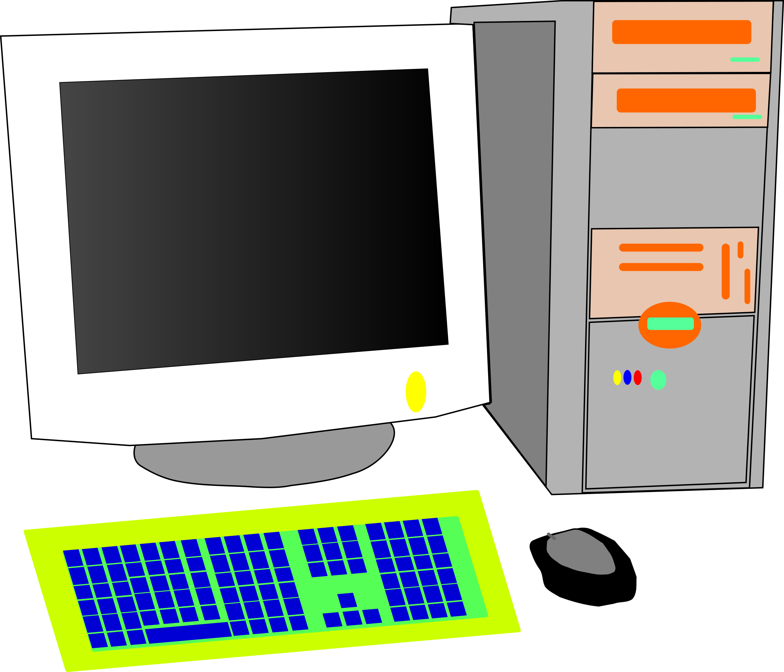
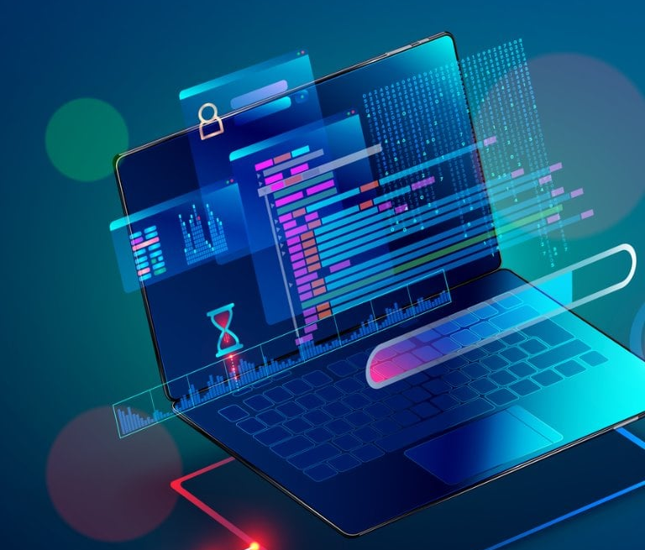
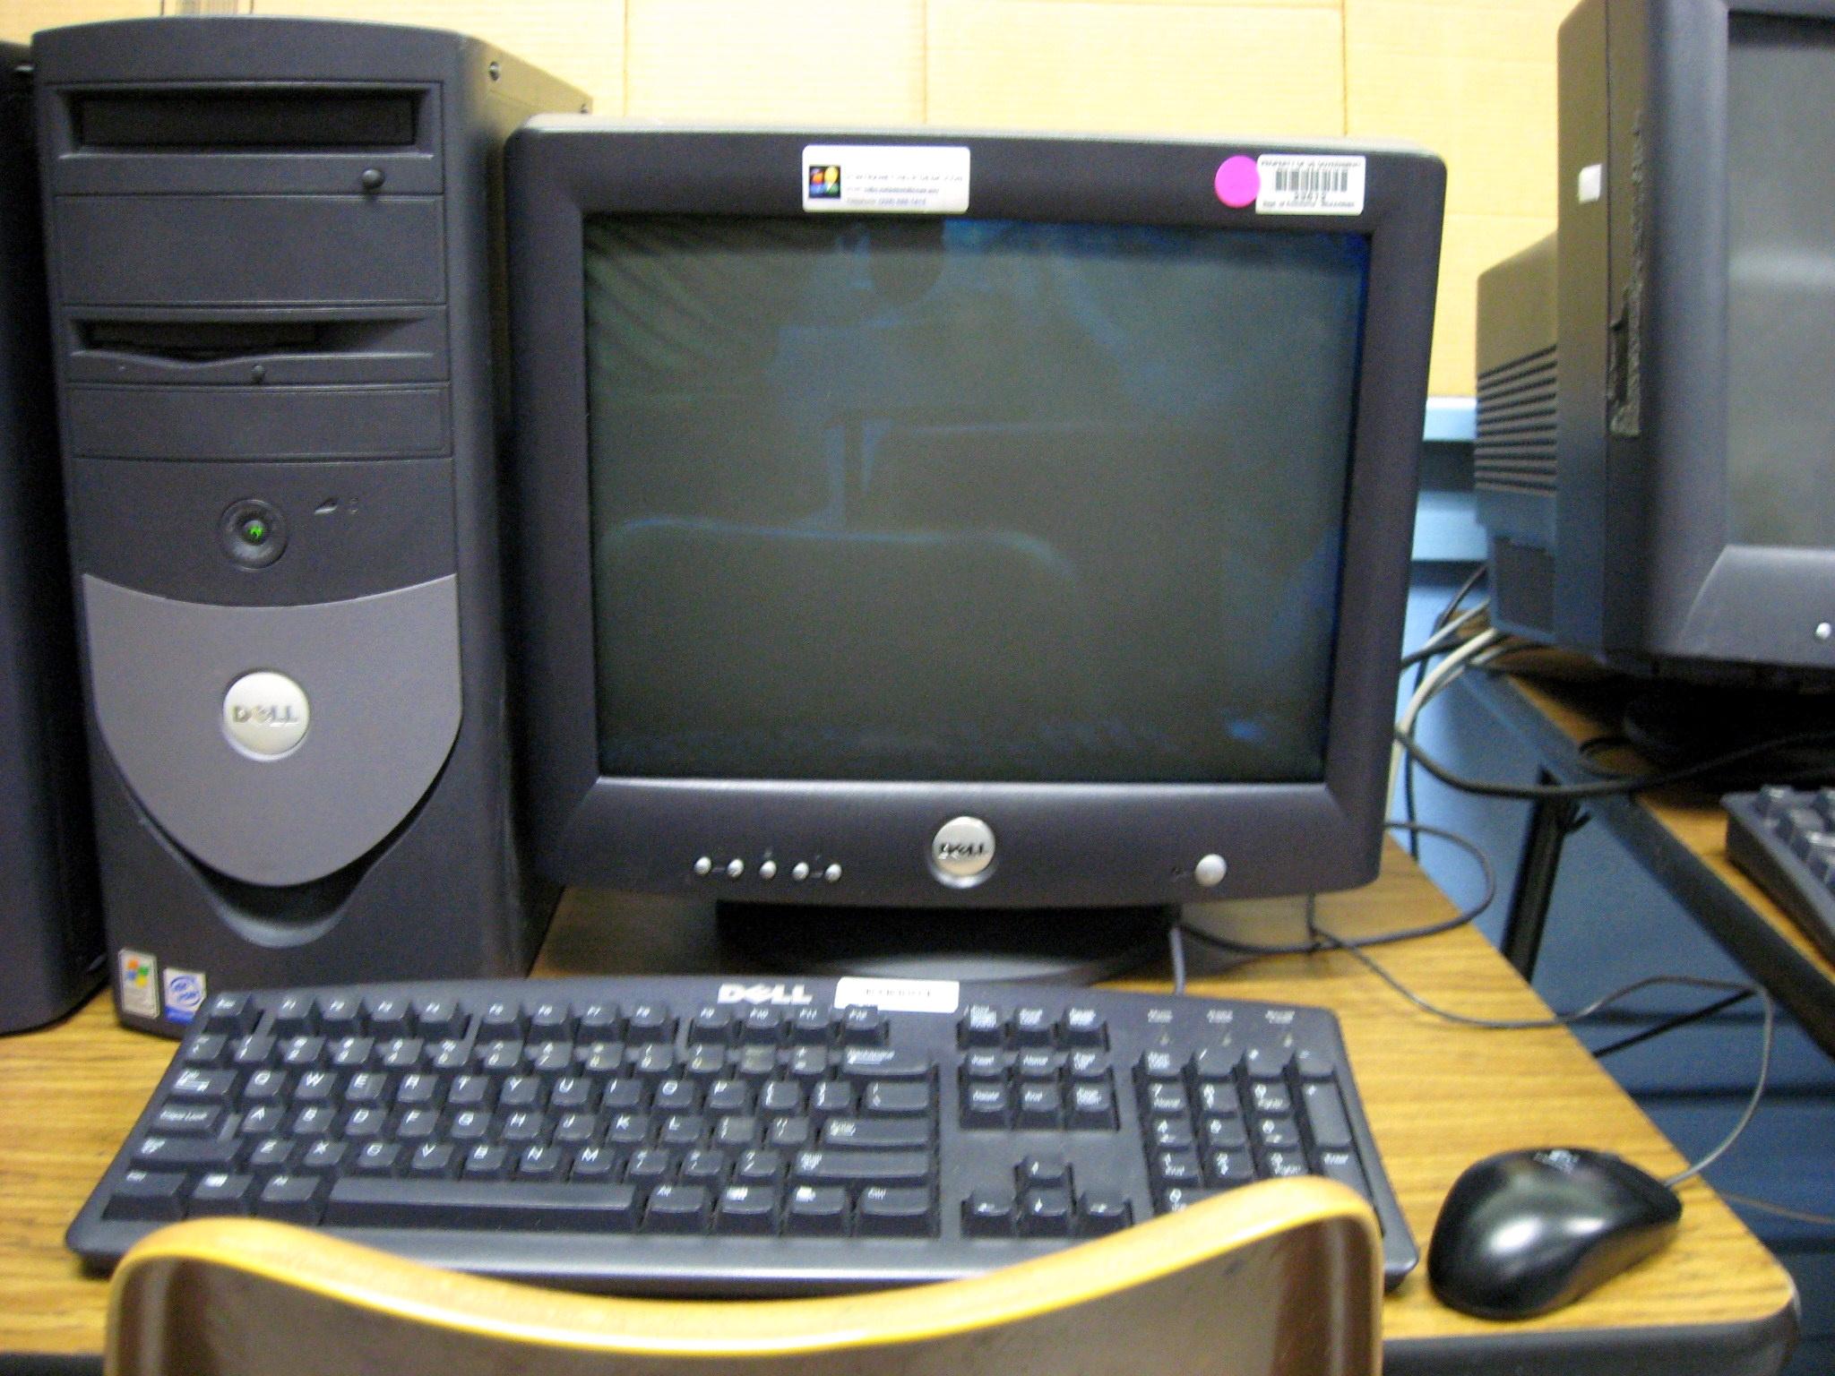
Chapter : 1 Introduction
What is a Computer?
A computer is an electronic machine that can receive data (input), process it, store it, and produce results (output). It operates under instructions (software) to perform a variety of tasks quickly and accurately.
Prepared by Ranjit Kumar Das

Slide 3
Chapter : 1 Introduction
Features of Computers:
Speed: Executes billions of instructions per second.
Accuracy: Very low chance of errors when instructions are correct.
Automation: Works on its own once given commands.
Storage: Stores massive amounts of data.
Diligence: No fatigue or distraction.
Multitasking: Handles multiple tasks simultaneously.
Versatility: Can be used in multiple domains like education, business, medicine.
Prepared by Ranjit Kumar Das

Slide 4
Chapter : 1 Introduction
Applications/Uses of Computers:
Education: E-learning platforms (Moodle, Google Classroom), research, programming.
Banking: ATMs, online banking, database management.
Medicine: Diagnosing diseases, robotic surgery, maintaining patient records.
Engineering: Design using CAD/CAM software.
Government: Record-keeping, public service automation.
Home: Entertainment, learning, e-commerce.
Prepared by Ranjit Kumar Das

Slide 5
Chapter : 1 Introduction
Importance of Computers in Medical Field
Computers play a vital role in healthcare. There are the following important key as follows:
Key Uses:
Electronic Health Records (EHRs): Store and access patient histories instantly.
Medical Imaging: X-rays, MRI, CT scans use computer processing.
Telemedicine: Remote consultation and monitoring.
Lab Testing: Automated blood tests, virus detection.
Hospital Information Systems (HIS): Manages staff, billing, reports.
Research: Drug discovery, disease modeling.
Wearable Devices: Track heart rate, oxygen, sleep, etc.
Prepared by Ranjit Kumar Das

Slide 6
Chapter : 1 Introduction
Computer Ergonomics & Health
Computer Ergonomics
The science of designing the computer workspace to minimize discomfort and injury.
Health Problems Due to Computers:
Eye strain (from screen glare)
Repetitive Strain Injury (RSI) – from typing/mouse overuse
Back and neck pain – due to bad posture
Stress – from continuous usage without breaks
Precautions:
Maintain correct posture
Use adjustable chairs and tables
Use anti-glare screen filters
Take frequent short breaks (20-20-20 rule: every 20 mins, look 20 feet away for 20 seconds)
Use wrist rests and ergonomic mouse
Prepared by Ranjit Kumar Das

Slide 7
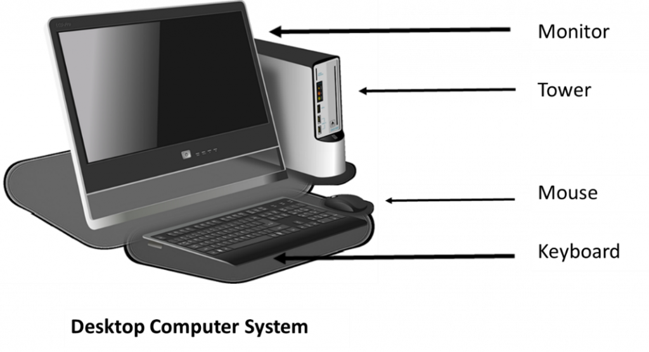
Computer Systems
Computer Systems
Main Parts of Computer System:
Hardware – Physical components
Software – Set of programs/instructions
Users – People who operate the computer
Data – Information input and processed
Prepared by Ranjit Kumar Das

Slide 8
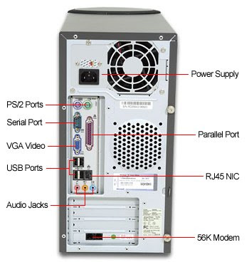
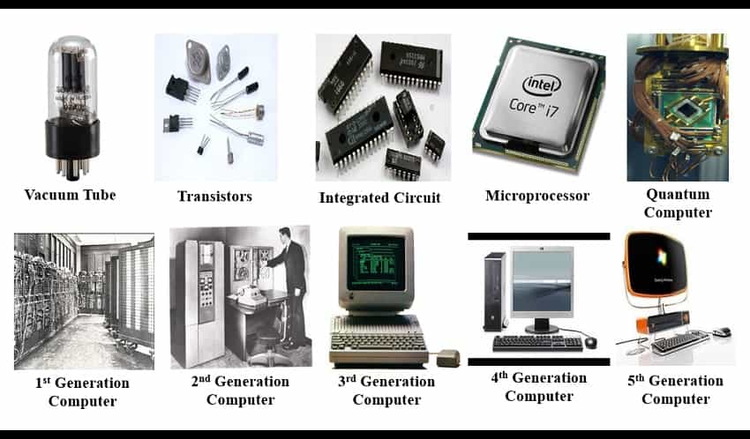
Computer Systems
Prepared by Ranjit Kumar Das

Slide 9
Computer Systems
Basic Hardware Components (Used to enter data into the computer.)
Device | Function
Keyboard | Typing text and commands
Mouse | Pointer control
Joystick | Used in gaming or flight simulations
Trackball | Cursor movement with a ball
Light pen | Draws directly on screen
Touch Pad | Used in laptops
Touch Screen | Finger-based interaction (mobiles, ATMs)
Digital Camera | Captures photos/videos
Scanner | Scans documents or images
OCR | Converts printed text to digital
OMR | Reads shaded areas (exams, surveys)
Digitizing Tablet | Used by artists for drawing
Prepared by Ranjit Kumar Das

Slide 10
Computer Systems
Processing Hardware:
CPU (Central Processing Unit): Brain of the computer
ALU: Performs math/logical tasks
CU: Controls operations
Registers: Temporary fast-access memory
Storage Devices:
Stores data permanently or temporarily.
Primary: RAM, ROM
Secondary: HDD, SSD, Optical discs, Pen drives
Prepared by Ranjit Kumar Das

Slide 11
Computer Systems
Output Devices:
Device | Function
CRT Monitor | Old monitor with vacuum tube
LCD Monitor | Flat and energy-efficient display
LED Monitor | Latest tech, clear picture, energy-saving
Dot Matrix Printer | Low-quality, impact type printer
Inkjet Printer | Prints high-res colored images
Laser Printer | Fast, high-quality print, non-impact
Thermal Printer | Used in receipts, quiet
Projector | Enlarges screen for presentations
Speakers | Plays audio output
Prepared by Ranjit Kumar Das

Slide 12
Computer Software
System Software
OS like Windows, Linux, macOS – Manages hardware/software
Device Drivers – Controls specific devices
BIOS – Loads OS from boot disk
Application Software
Microsoft Office, Photoshop, Tally
Helps users perform tasks
Utility Software
Antivirus, disk cleaners, compression tools
Maintains system health and efficiency
Prepared by Ranjit Kumar Das

Slide 13
Computer Software
System Software
OS like Windows, Linux, macOS – Manages hardware/software
Device Drivers – Controls specific devices
BIOS – Loads OS from boot disk
Application Software
Microsoft Office, Photoshop, Tally
Helps users perform tasks
Utility Software
Antivirus, disk cleaners, compression tools
Maintains system health and efficiency
Prepared by Ranjit Kumar Das

